Slide 1
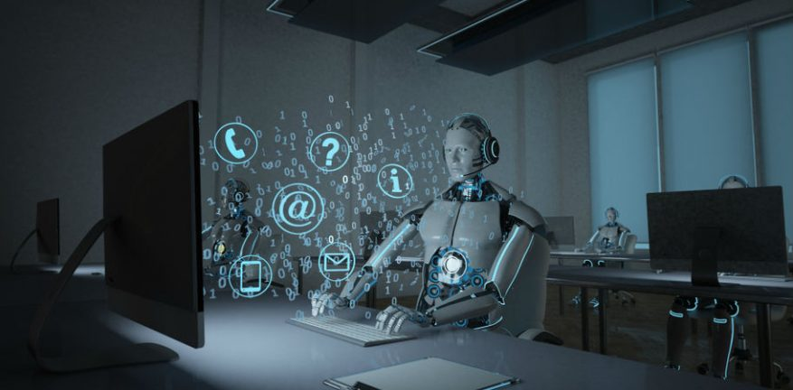
Customer services "calls & agents" forecasting
All we care about is supporting business decisions using industry and open analytics
https://forecasting-calls-agents.herokuapp.com/

Slide 2
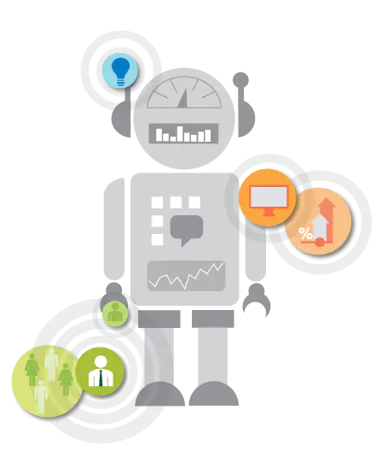
This model is a method of data analysis that automates analytical model building. It’s a branch of artificial intelligence based on the idea that systems can learn from data, identify patterns and make decisions with minimal human intervention.

